Slide 1
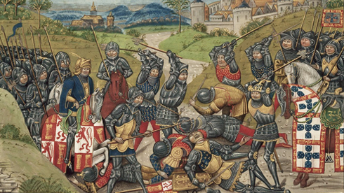
The Feudal System

Slide 2
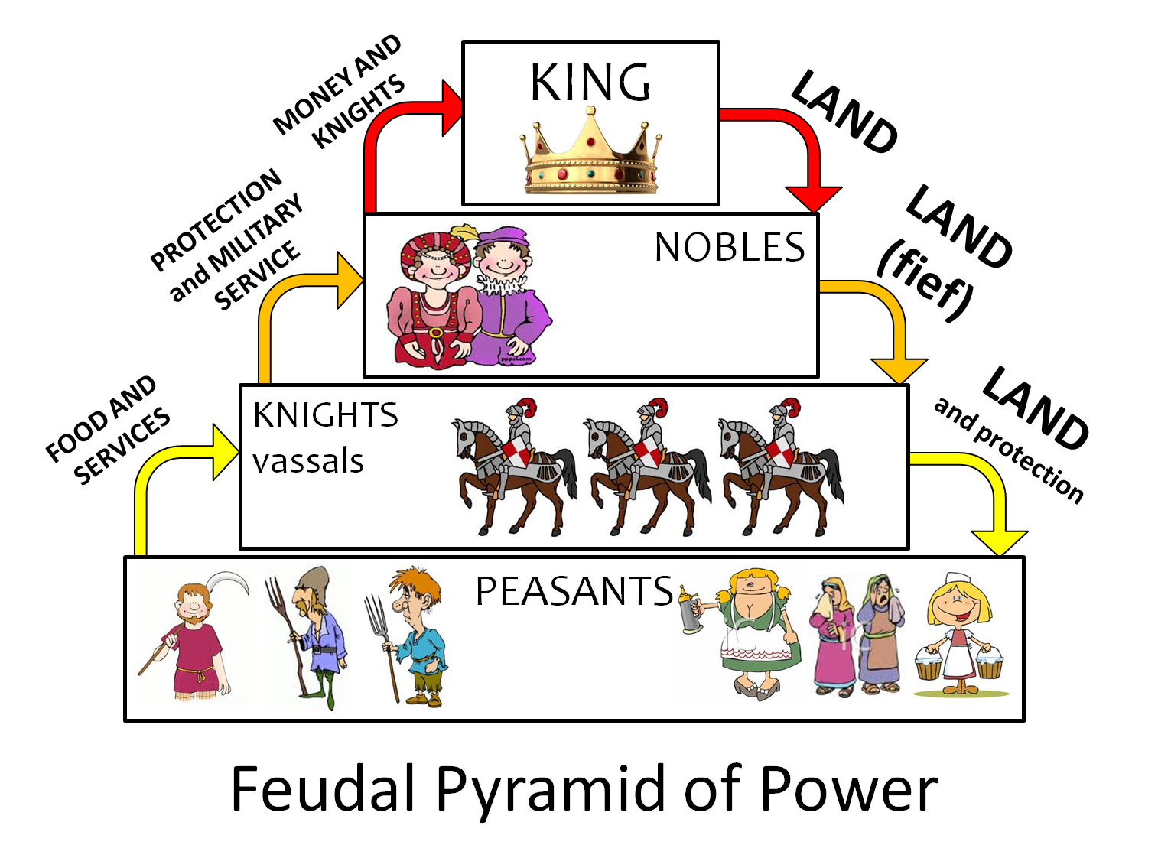
What is Feudalism?
Click the link for a quick clip to review the Feudal System
http://www.youtube.com/watch?v=HCPp7XWZfHo&list=PL949F2F18D3AB09C1

Slide 3
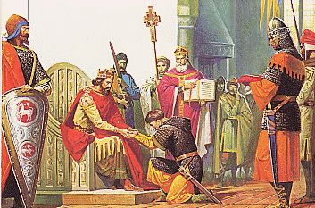
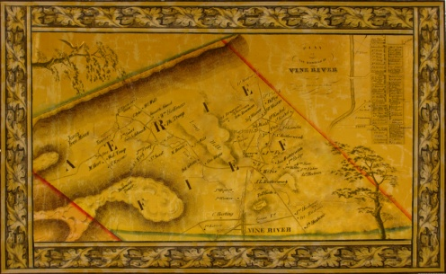
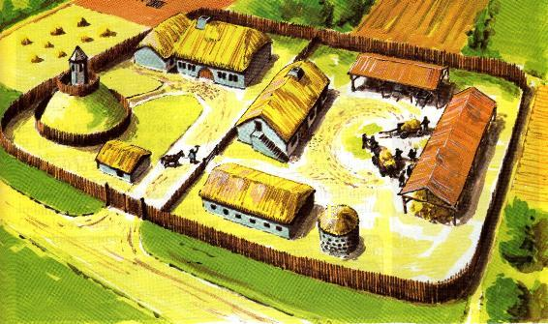
What are some important terms?
Vassal- A vassal is anyone who receives land in exchange for loyalty and service.
Fief- A fief is land that was given to a vassal in exchange for their loyalty.
Manor- Many fiefs were divided into these. It was a small village, some farmland, and a manor house.

Slide 4
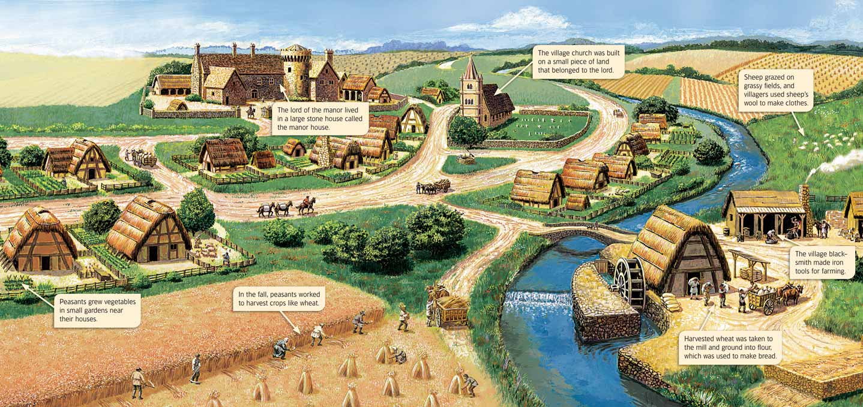
A Typical Medieval Manor Looked Like This

Slide 5
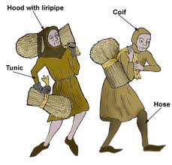
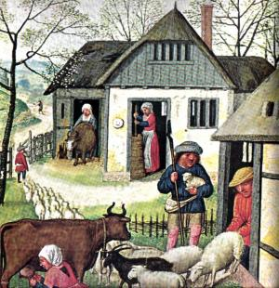
Life at the Bottom- Peasants
Most of the village people were called serfs or villiens. The lord of the manor gave each serf space for a house and small garden, strips in the farming fields and a share in the hay meadow, common land and woodland. Instead of paying rent, the serfs would work on certain days for the lord.In February or March, they would do several days’ plowing on the lord’s land but they had to provide their own food. Once in summer and once in autumn, they would be expected to do one day’s plowing and one day’s harrowing ( flattening out the plowed soil), but on these occasions the lord would give them food twice a day.
There would also be other regular work to be done on the lord’s strips, like removing the weeds. Besides this work, week by week, there were special times when the serf’s whole family had to work; cutting and carrying the lord’s hay and reaping and carrying his corn

Slide 6
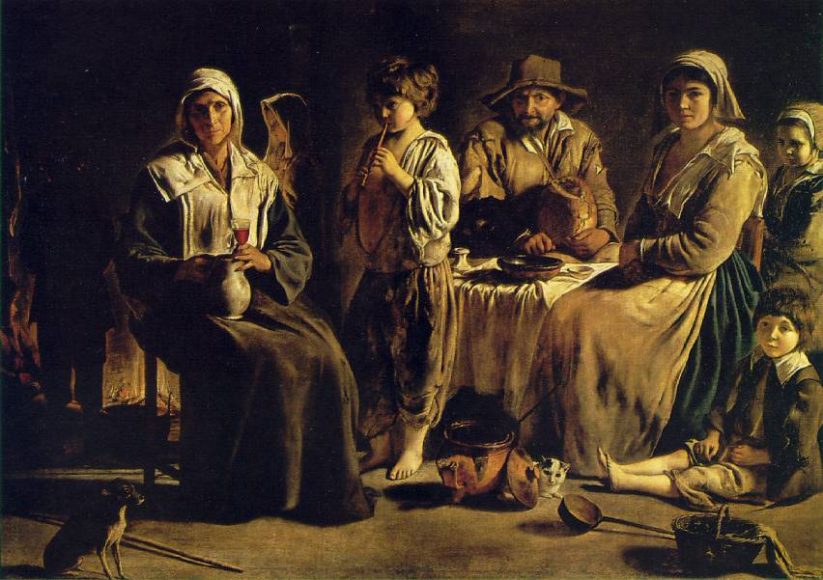
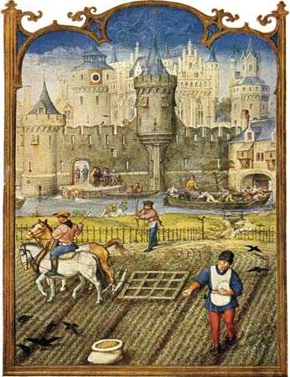
Life at the Bottom-Peasants
Although not technically a slave, a serf was bound to a lord for life. He could own no property and needed the lord's permission to marry. Under no circumstance could a serf leave the land without the lord's permission unless he chose to run away. If he ran to a town and managed to stay there for a year and a day, he was a free man. However, the serf did have rights. He could not be displaced if the manor changed hands. He could not be required to fight, and he was entitled to the protection of the lord.

Slide 7
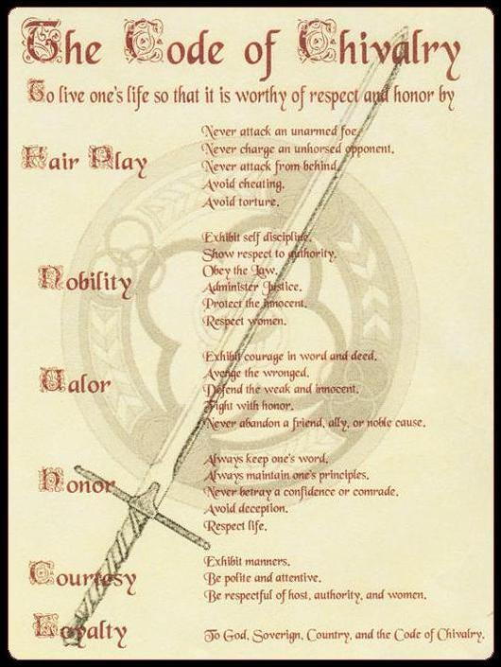
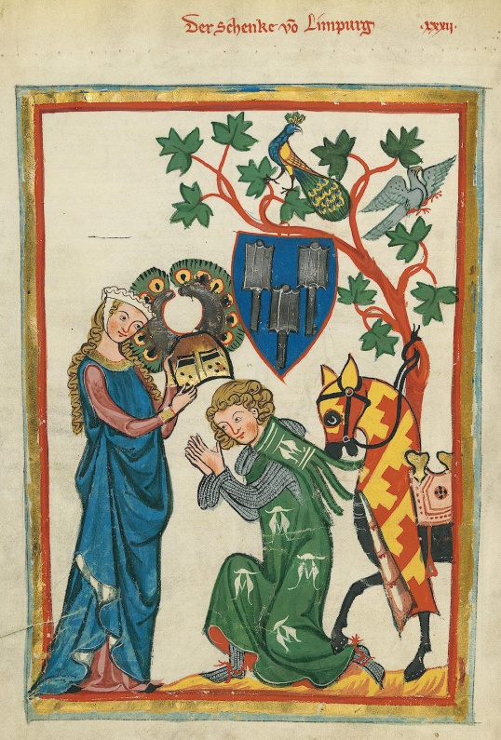
Armed Warriors- Knights
The word Knight‘ comes from an Anglo-Saxon word "Cniht" meaning "boy" or "page boy.
Knights were first introduced to Europe by Charlemagne.
Knights had to go through several steps before they became a knight. As a boy between the age of 6-8 they would become a page. At the age of 14-16 they would become a squire. At about the age of about 21 if he was worthy he would go through a dubbing ceremony and would become a knight.
Once he became a knight he had to follow the code of chivalry which dictated that a knight should be brave and fearless in battle but would also exhibit cultured Knightly qualities showing themselves to be devout, loyal, courteous and generous. Various ceremonies were attended and oaths made before a man could become a knight. The Code of Chivalry was a moral system which went beyond rules of combat and introduced the concept of Chivalrous conduct and courtly love.

Slide 8
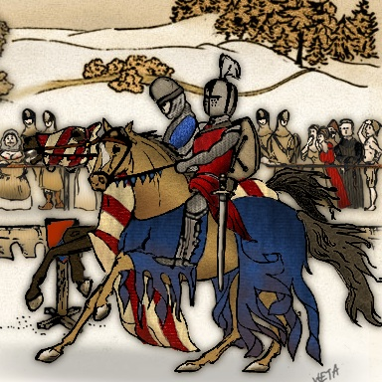
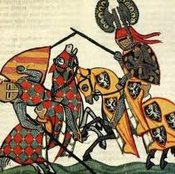
Armed Warriors-Knights
Daily Life of a Knight in the Middle Ages The daily life of a knight in the Middle ages followed a similar schedule to that of his lord or the noble he served. The daily life of a Knight during the Middle ages centered around castles or manors or fighting for his lord and the King during times of war.
Typical Day
The daily life of a Knight started at dawn when Mass would be heard and prayers would be made
Knights would engage in weapons
Mid morning prayers and a meal
As the Medieval period progressed the culture changed becoming more refined and elegant. Knights were expected to understand the rules of Chivalry and courtly love. Time might be spent on dance practice
In the afternoon the Knights turned to increasing their skills in horsemanship and would accompany their lord in hunting, hawking or inspecting the estate
Evening prayer and then supper in the Hall of the Castle or Manor House
After supper there might be some entertainment - music, dancing, jugglers, acrobats, jesters, etc

Slide 9
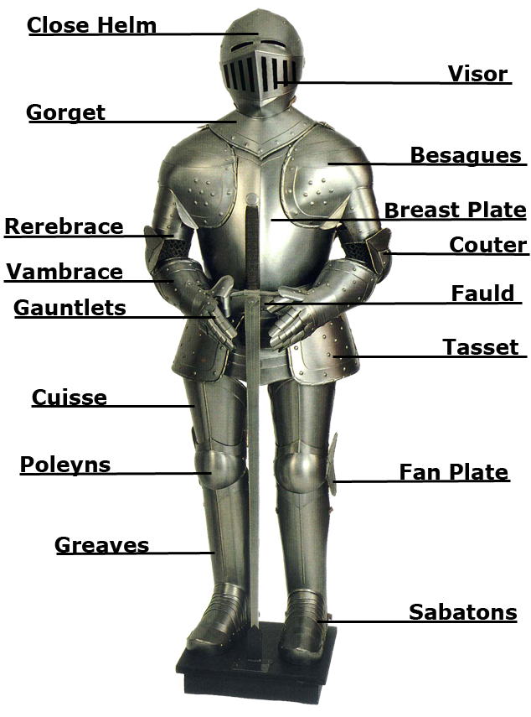
A Knight’s Armor
What do you think each of the parts did?
What advantages did this armor have? What about disadvantages?

Slide 10
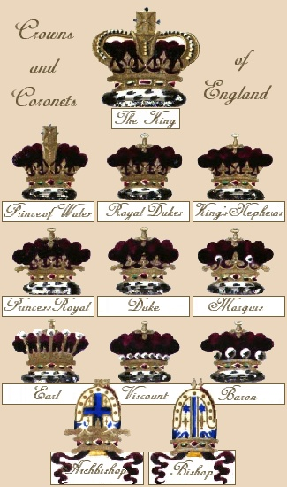
Of Noble Birth- Nobles
Baron, lord, duke, earl, count, marquis, these are all titles of nobility. They are all nobles. You were born a noble in the Middle Ages and your children became nobles as well.
Nobles oversaw their fiefdom which may have included several manors who they gave to their vassals (lesser lords).

Slide 11
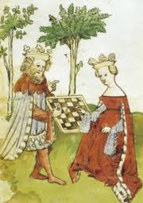
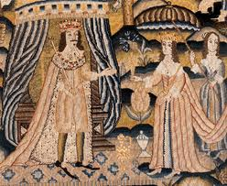
Its good to be the king(or queen)-Monarchs
Monarchs were also of noble birth but had inherited their power from their mother or father. You could not marry into the position of sole leader it had to be inherited. Monarchs ruled with absolute power in the Middle Ages and ruled by Divine Right, the belief that their power came directly from God. When you died your power passed to the oldest born son or if there was none the oldest daughter.

Slide 12
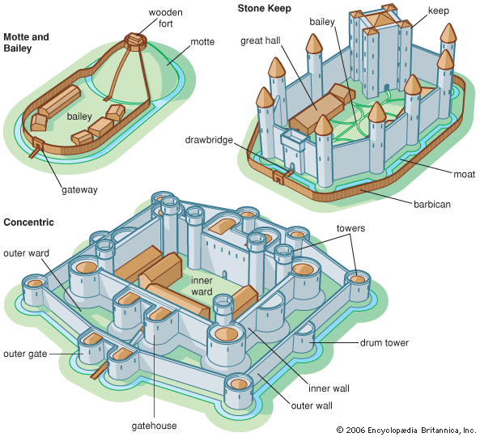
Stone Sweet Home-Castles
Castles were the homes of both nobles and kings.
Over time castle builders made improvements to the types of castles that were made.
The first type were motte and bailey, made of wood and earth.
The second were stone keeps, named for the innermost part of the castle, the keep.
Last to come along were concentric castles, which had two layers of walls.

Slide 13
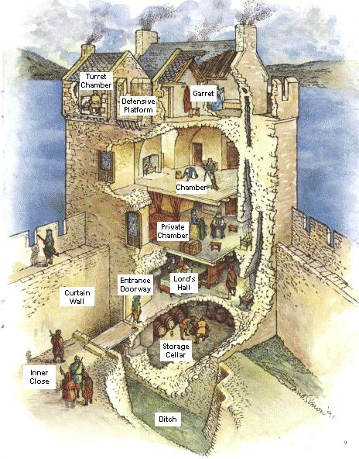
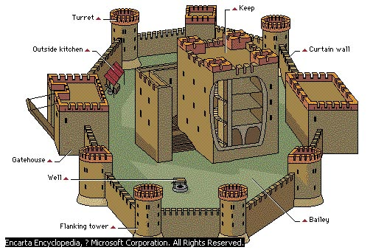
Stone Sweet Home-Castles

Slide 14
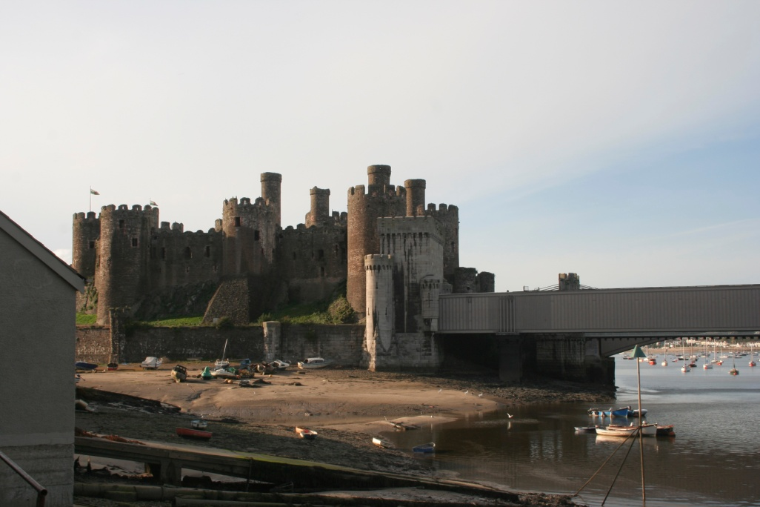
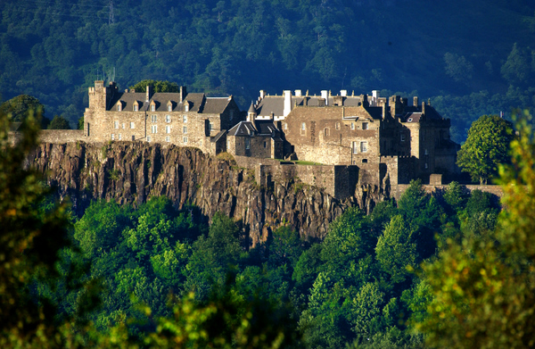
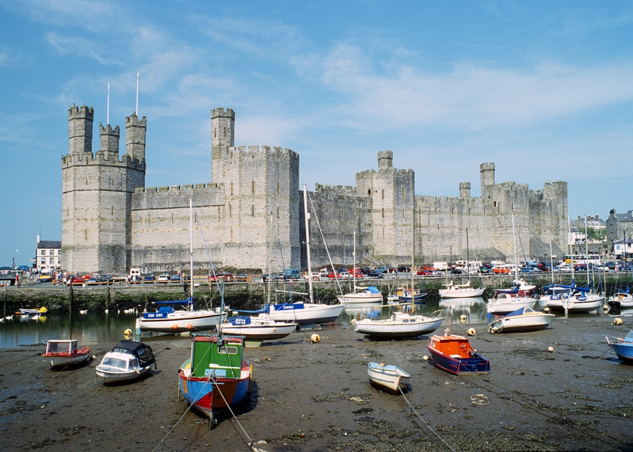
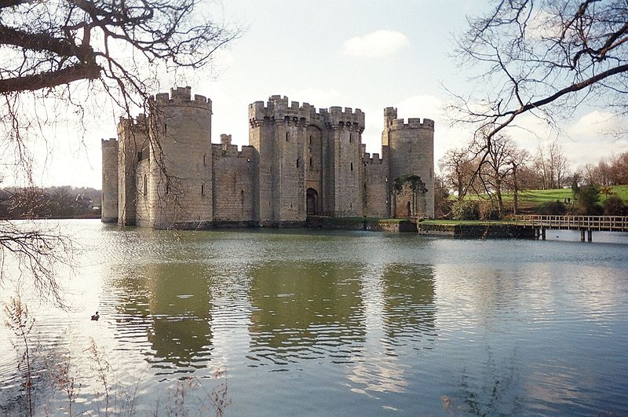

Slide 15
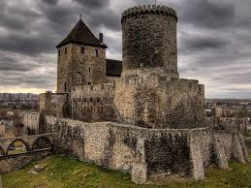
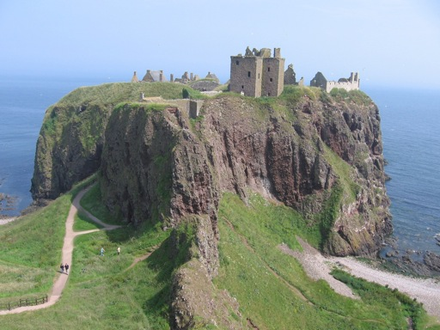
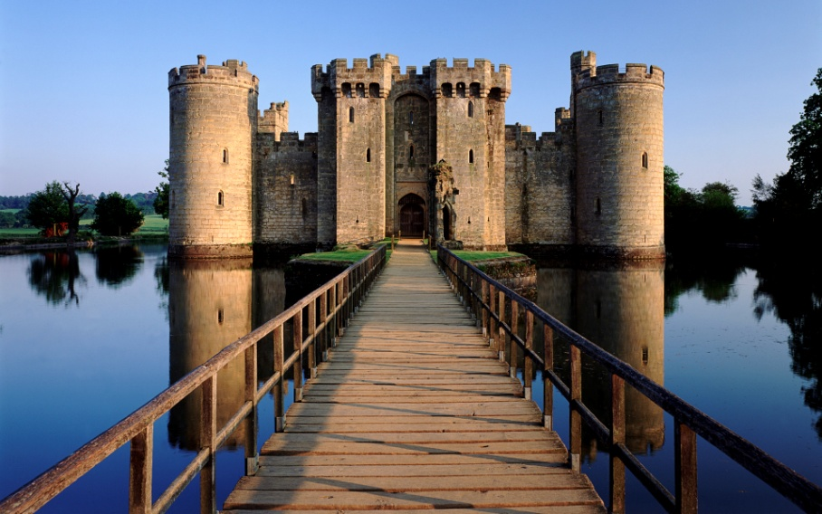
Castle Clips
http://whc.unesco.org/en/list/488/video
http://whc.unesco.org/en/list/374/video

